Slide 1
Interference in Mobile Computing

Slide 2
Interference
When the wireless communication signals are disrupted or weakened by the presence of other wireless signals, it is considered to be interference.
Why is interference an issue?
It can reduce the signal strength between the MS (Mobile Station, aka your handset) and the BTS (Base Transceiver Station, aka tower).
The chances of dropped calls increases due to the weakened signal reception.
Disturbance during call
Missed call
Disconnection
Sources
Another mobile in same cell
Ongoing call in neighboring cell
When a different base station operate on same frequency

Slide 3
Types of channels on which interference is present are-
On Voice Channel: leads to crosstalk which is an interference or background noise while we are talking to another person on mobile. Crosstalk is unwanted interference that should be minimized.
On Control Channel: It can lead to problems in creating a connection between the sender and receiver during a call which leads to missed calls. Calls may terminate abruptly known as blocked calls.

Slide 4
Types of Interference in Mobile Communication
Co-Channel Interference
Adjacent Cell Interference

Slide 5
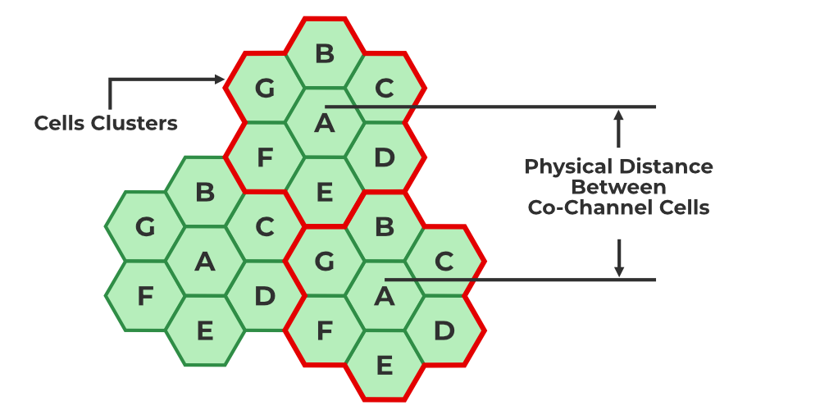
Co-Channel Interference
Co-channel cells are those cells that use the same frequency in a given coverage area. Interference from these cells is called co-channel interference.
Cochannel interference is also known as inter-cell interference.
In co-channel interference, the cells are clustered as close together as possible to reduce the co-channel interface and provide sufficient isolation.
Increasing the co-channel reuse ratio improves the transmission quality because of the smaller level of co-channel interference.
An example of co-channel interference is when a radio transmitter is operating on the same frequency.

Slide 6
The reasons behind Co-channel interference are:
Bad weather condition
Poor frequency planning
Ways we can reduce co-channel interference in cellular communication are:
Proper planning and implementation.
The frequency reuse technique increases overall system capacity.

Slide 7
Adjacent Channel Interference
It is the interference caused to the signal which is adjacent in frequency to the desired signal.
Imperfect receiver side filters allow the neighboring signal to mix with the actual pass band.
If adjacent channel signal strength becomes strong, it will be difficult for Base Station to differentiate the actual mobile signal from the strong mobile signal.

Slide 8
The reasons behind adjacent channel interference are as follows:
Due to multiple channels close to each other communicating using similar frequencies.
Irrelevant power emission from an adjacent channel.

Slide 9
Factors for reducing Adjacent Channel Interference are as follows:
Proper filtering
Careful Channel Assignments
By managing the space between two adjacent cells which should remain constant.

Slide 10
Frequency Reuse
The ability to use the same frequencies repeatedly across a cellular system.
As each cell uses radio frequencies only within its boundaries, the same frequencies can be reused in other cells not far away with a limited possibility of interference.
The reuse of frequencies is the key concept that enables a cellular system to handle a large amount of calls with a limited number of channels.

Slide 11
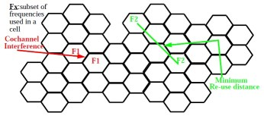
Frequency Reuse
To be able to increase the capacity of the system, frequencies must be re-used in the cellular layout
Frequencies cannot be re-used in adjacent cells because of co-channel interference.

Slide 12
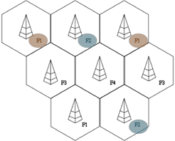
To serve hundreds of thousands of users, the frequency must be reused and this is done through cells. The area to be covered and subdivided into radio zones or cells.
Base station positioned at the center of the cell. Data communication in cellular networks served by its base station transmitter, receiver, and its control unit.
The regular repetition of frequencies in cells results in a clustering of cells. The clusters generated in this way can consume the whole frequency band.
Cellular mobile radio systems that use TDMA and FDMA rely upon frequency reuse, where users in geographically separated cells simultaneously use the same carrier frequency.
Frequency Reuse Distance

Slide 13
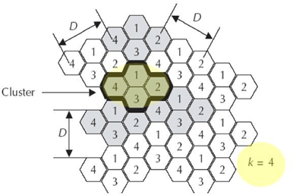

The co-channel reuse factor D / R, is defined as the ratio of the co-channel reuse distance D between cells using the same set of carrier frequencies and the radius of the cells R1. For hexagonal cells, the reuse cluster size N and the co-channel reuse factor D/R are related by below mentioned equation.
co-channel reuse factor
Frequency Reuse Distance

Slide 14
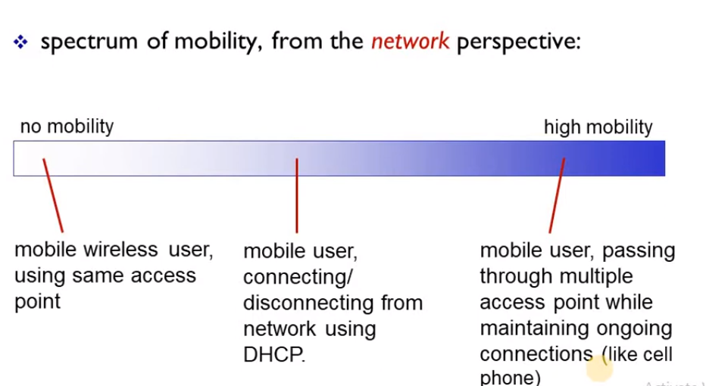
Mobility Management
What is Mobility?

Slide 15
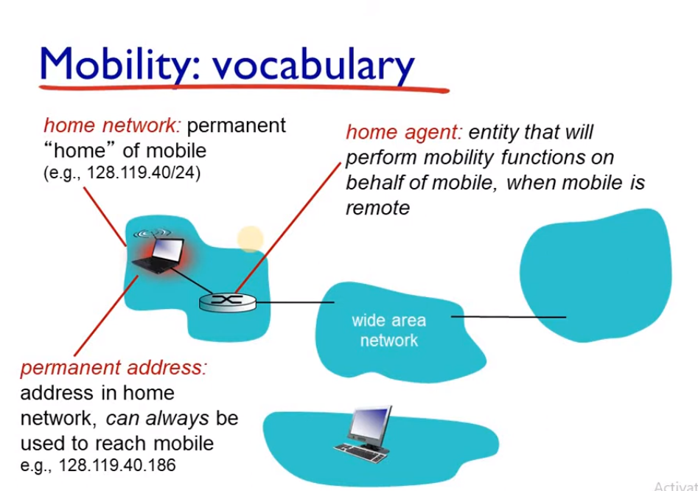

Slide 16
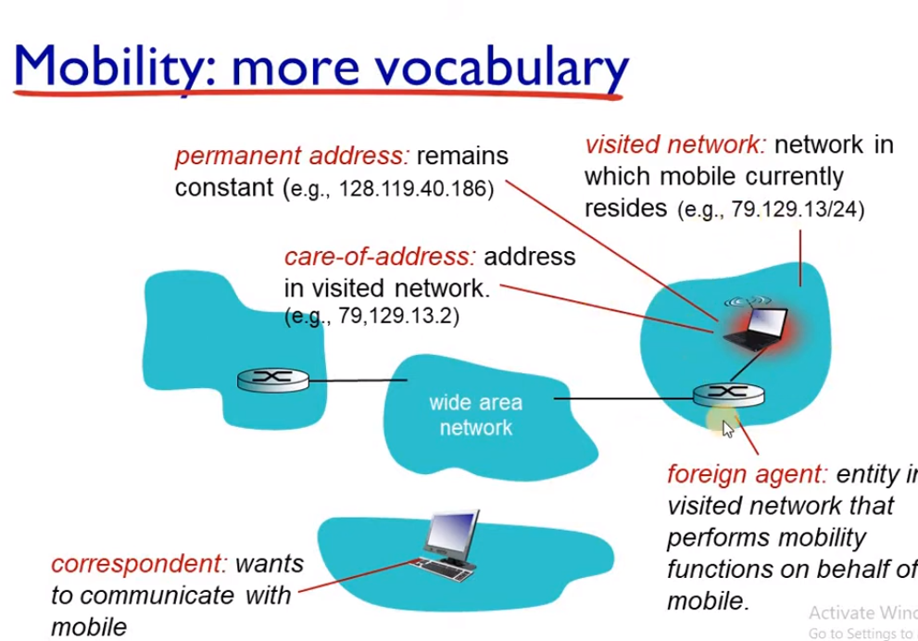

Slide 17
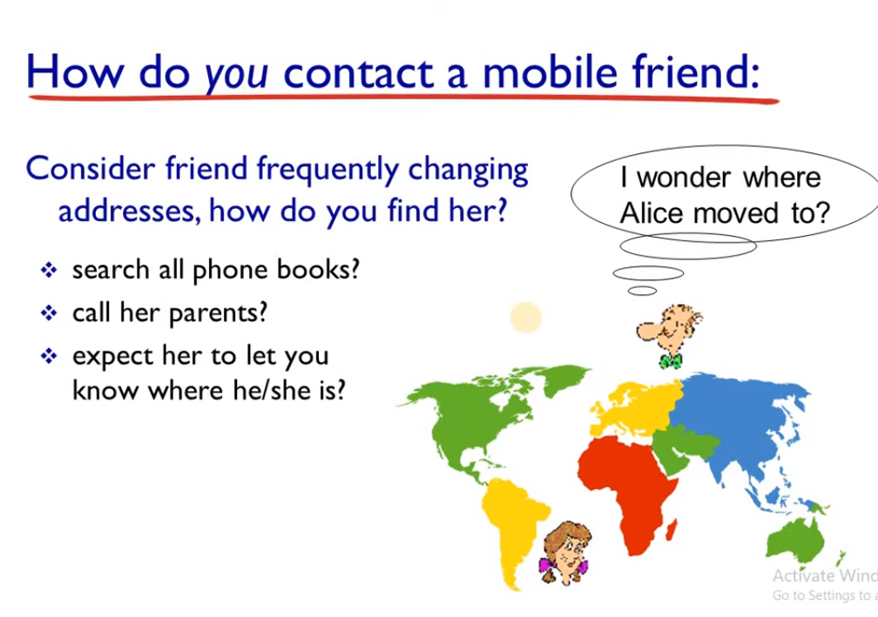

Slide 18
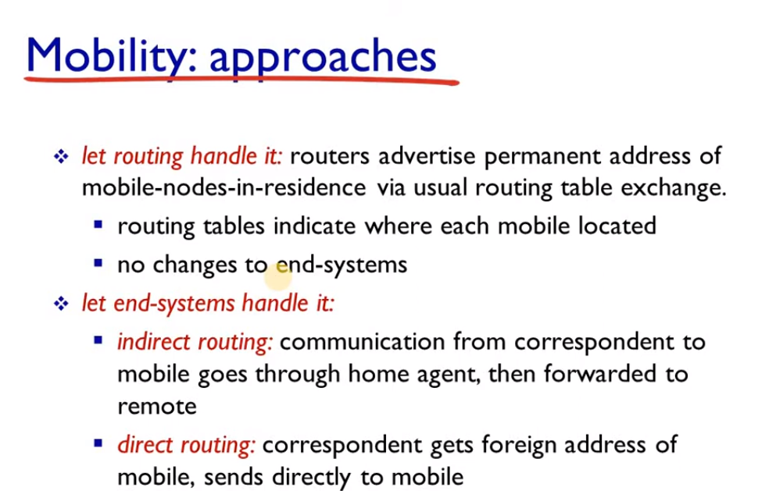

Slide 19
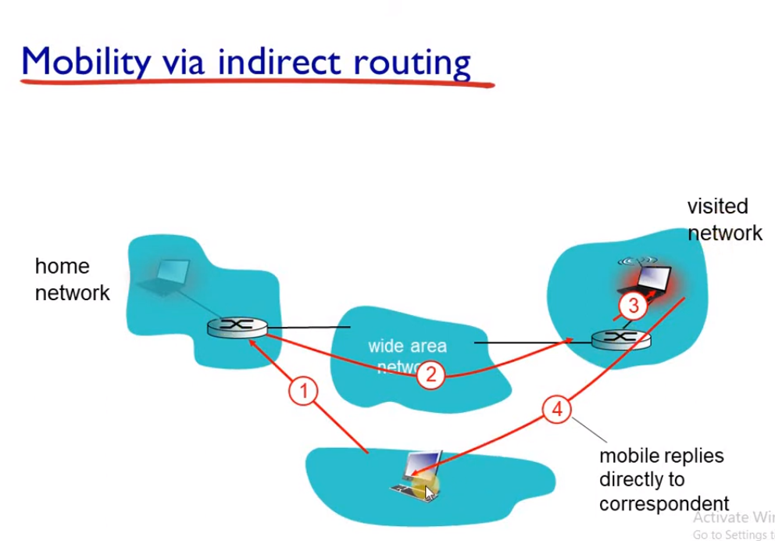

Slide 20
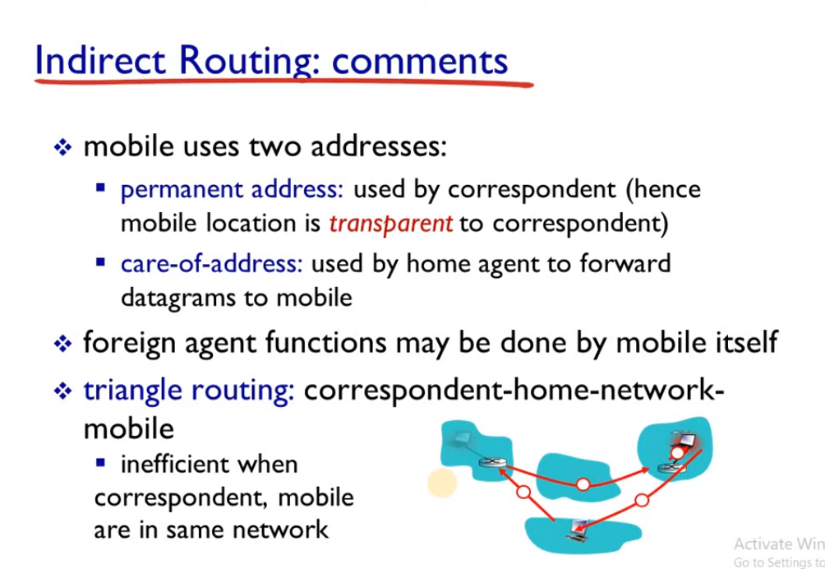

Slide 21
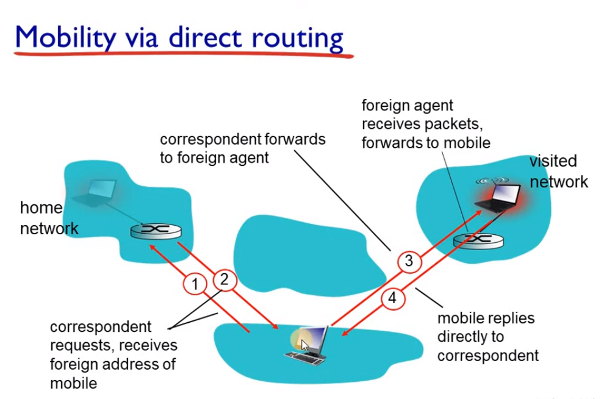

Slide 22
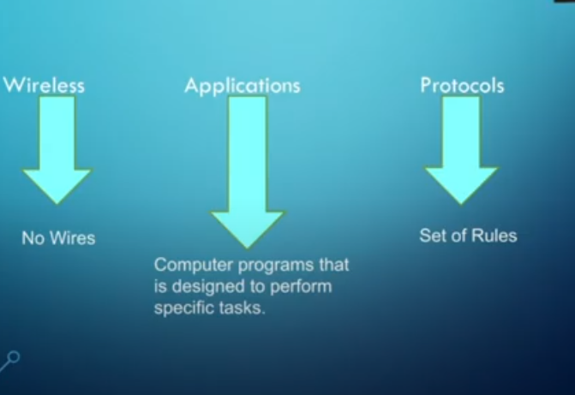
Wireless Application Protocol
WAP stands for Wireless Application Protocol. It is a protocol designed for micro-browsers and it enables the access of internet in the mobile devices.

Slide 23
Why is WAP Important?
Until the first WAP devices emerged, the Internet was a Internet and a mobile phone was a mobile phone. You could surf the Net, do serious research, or be entertained on the Internet using your computer, but this was limited to your computer.
Now with the appearance of WAP, the scene is that we have the massive information, communication, and data resources of the Internet becoming more easily available to anyone with a mobile phone or communications device.
WAP being open and secure, is well suited for many different applications including, but not limited to stock market information, weather forecasts, enterprise data, and games.
Despite the common misconception, developing WAP applications requires only a few modifications to existing web applications.
The current set of web application development tools will easily support WAP development, and in the future more development tools will be announced.

Slide 24
It uses the mark-up language WML (Wireless Markup Language and not HTML), WML is defined as XML 1.0 application. It enables creating web applications for mobile devices.
In 1998, WAP Forum was founded by Ericson, Motorola, Nokia and Unwired Planet whose aim was to standardize the various wireless technologies via protocols.
WAP protocol was resulted by the joint efforts of the various members of WAP Forum. In 2002, WAP forum was merged with various other forums of the industry resulting in the formation of Open Mobile Alliance (OMA).

Slide 25
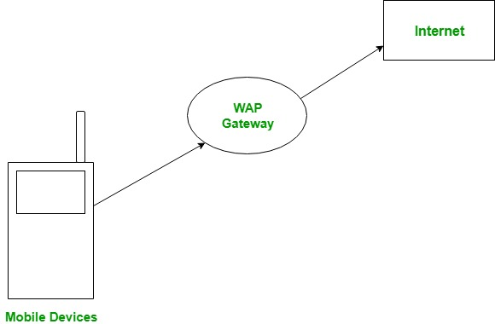
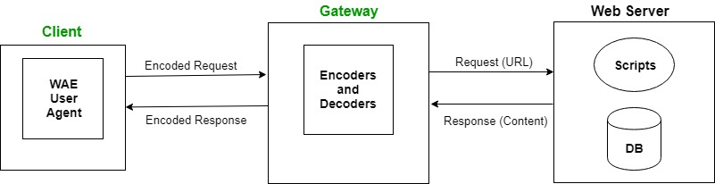
WAP Model:
The user opens the mini-browser in a mobile device.
He selects a website that he wants to view.
The mobile device sends the URL encoded request via network to a WAP gateway using WAP protocol.
The WAP gateway translates this WAP request into a conventional HTTP URL request and sends it over the internet.
The request reaches to a specified Web server and it processes the request just as it would have processed any other request and sends the response back to the mobile device through WAP gateway in WML file which can be seen in the micro-browser.

Slide 26
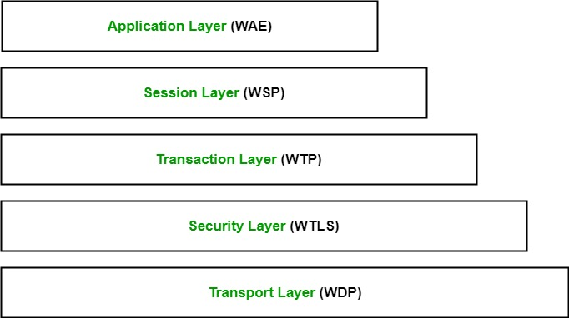
WAP Protocol stack:
Application Layer: This layer contains the Wireless Application Environment (WAE). It contains mobile device specifications and content development programming languages like WML.
Session Layer: This layer contains Wireless Session Protocol (WSP). It provides fast connection suspension and reconnection.
Transaction Layer: This layer contains Wireless Transaction Protocol (WTP). It runs on top of UDP (User Datagram Protocol) and is a part of TCP/IP and offers transaction support.
Security Layer: This layer contains Wireless Transaction Layer Security (WTLS). It offers data integrity, privacy and authentication.
Transport Layer: This layer contains Wireless Datagram Protocol. It presents consistent data format to higher layers of WAP protocol stack.

Slide 27
Advantages of Wireless Application Protocol (WAP)
WAP is a very fast-paced technology.
It is an open-source technology and completely free of cost.
It can be implemented on multiple platforms.
It is independent of network standards.
It provides higher controlling options.
It is implemented near to Internet model.
By using WAP, you can send/receive real-time data.
Nowadays, most modern mobile phones and devices support WAP.

Slide 28
Disadvantages of Wireless Application Protocol (WAP)
The connection speed in WAP is slow, and there is limited availability also.
In some areas, the ability to connect to the Internet is very sparse, and in some other areas, Internet access is entirely unavailable.
It is less secured.
WAP provides a small User interface (UI).

Slide 29
Applications of Wireless Application Protocol (WAP)
WAP facilitates you to access the Internet from your mobile devices.
You can play games on mobile devices over wireless devices.
It facilitates you to access E-mails over the mobile Internet.
Mobile hand-sets can be used to access timesheets and fill expenses claims.
Online mobile banking is very popular nowadays.
It can also be used in multiple Internet-based services such as geographical location, Weather forecasting, Flight information, Movie & cinema information, Traffic updates etc. All are possible due to WAP technology.

Slide 30
Transaction Processing in Mobile Environment
A transaction processing system allows application programmers to concentrate on writing code that will allow users to perform transactions simultaneously without bothering about what other users may be doing with their transactions at the same time.
It manages the concurrent processing of transactions.
It enables the sharing of data.
It ensures the integrity of data.

Slide 31
Issues in Transaction Processing
Database applications are normally structured into transactions.
The transaction is a type of operation that makes sure that database does not change into an inconsistent state to disrupt the transactions.
One important aim in the design of any database system is to maximize the number of transactions that can be active at a time. DBMS ensures serializability using ACID constraints:
Atomicity
Consistency
Isolation
Durability

Slide 32
ACID properties have been redefined to support transactions in the mobile environment are:
Atomicity Relaxation: Mobile Host is allowed to submit pieces of the transaction from different cells according to the movement.
It requires the ability to break a transaction into many sub-transactions that can be concurrently executed.

Slide 33
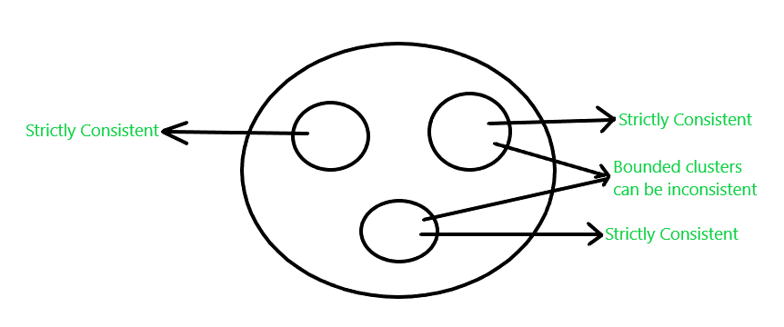
Consistency Relaxation: The database is logically partitioned into “clusters” based on some attributes.
Data in the same cluster must be strictly consistent.
Although the bounded degree of inconsistency is tolerated among the clusters.

Slide 34
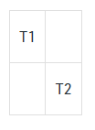
Isolation Relaxation: The intermediate results of a transaction can be observed by other concurrent transactions.
For example, if T1 is a transaction process and T2 is another transaction process then T1 should not be visible to T2.
T1 and T2 are two transaction processes where the operation of T1 is not seen by T2.

Slide 35
Durability Relaxation: A disconnected Mobile Host can only commit a transaction locally if this transaction does not conflict with other transactions executed on the same HOST while HOST was disconnected.

Slide 36
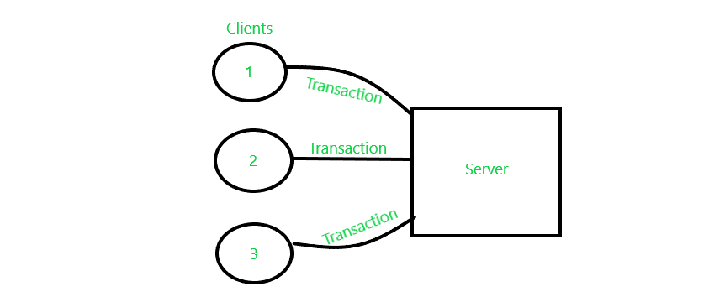
Transaction Processing Environment
1. Centralized Environment: Single user system executes all the transactions.
2. Client Server Environment: Transaction and transaction initiation are done by the server and client respectively. Many clients can send transactions to servers simultaneously.

Slide 37
3. Distributed Environment: Data is distributed over a network. The transaction can occur fully on a node or partially on a different node.
4. Mobile Environment: Special type of distributed environment can accommodate user movements while processing transactions.

Slide 38
Issues in Mobile Environment
User Movement: Tracking users, and data recovery are complicated. Location determination is complex.
Disconnections: There may be temporary disconnections due to noise, fading of signal, handoff, etc.
If there are planned disconnections, then the mobile user can perform some operations by downloading data beforehand. It can be referred to as data hoarding.
Another way to deal with disconnection is by migrating transaction processing to a non-mobile computer.
Poor Communication Media- Bandwidth allocated to mobile users could be very low. Interference from other traffic, noise, etc may corrupt data. MH tends to disconnect from the network whenever there is no data to send or receive in the near future.

Slide 39
Processing Power- With a less powerful CPU, database server operation is difficult.
Memory- Memory availability is limited.
Battery Power- Like memory, battery power is also limited.
User Interface- It should be designed keeping in mind resource restrictions.
Security- Chances of data theft and unauthorized access increases while MH moves from one cell to another.

